Slide 1
Gam3ya
Product Presentation by:
Mohamed Tarek
Ahmed Ibrahim
Mohamed ElAtroush
Omar Radwan

Slide 2
About the Product
Gam3ya is an innovative application that enables users to participate in a money-lending scheme online. It operates on both main mobile phone operating systems (Android and iOS) as well as PCs. Through sustained efforts, the application is safe, secure and reliable!

Slide 3
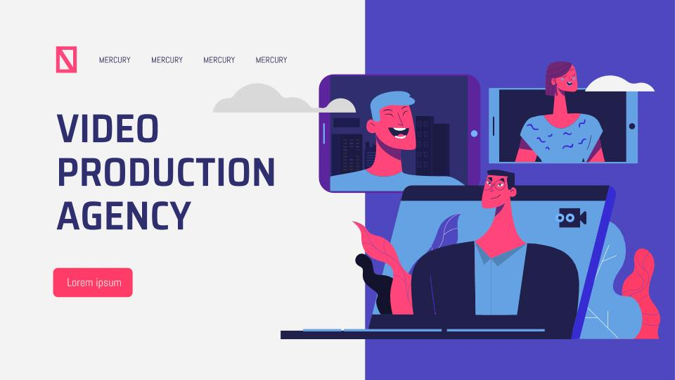
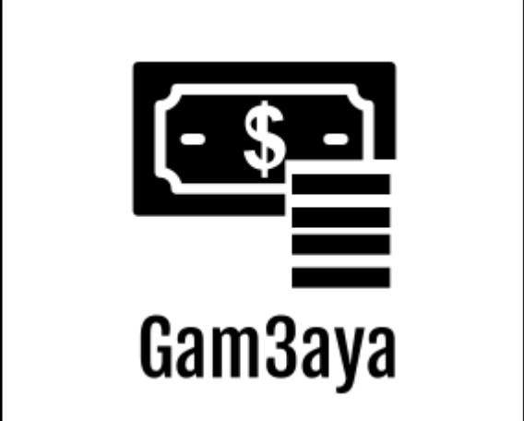
SNEAK PEEK
VIDEO PRODUCTION AGENCY
PC environments
Mobile environments (iOS, Android)
Log in ...

Slide 4
How does the product look?

Slide 5
Software Requirements Specifications
This was the first completed document by the developers, it contains critical information that details how the software application functions and operates for the user. The software product is called “​Gam3ya”​ , it’s an app mimicking reality when it comes to actual lending associations but in a more efficient, fast and secure approach.

Slide 6
Software Design Document
This software design document documents the architecture and system design of our Gam3aya application. This document is important to all the developers who will be working on developing/implementing the system, as well as the project manager. This document includes the data design, architecture design, interface design, and procedural design.

Slide 7
Software Design
Architectural Model: Layered Architecture
A type of client-server approach, it benefitted us since it allows for the physical components, data management functions and application processing to be conducted/tested separately.

Slide 8
Prototype
Ready to be verified after it has completed initial implementation.

